Slide 1
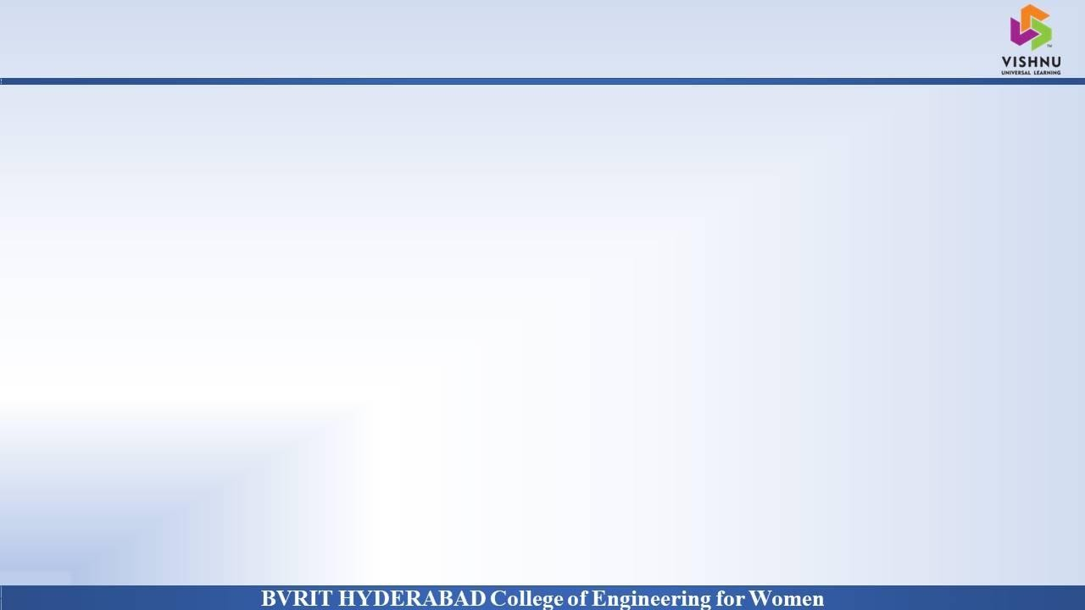
Department of Computer Science and Engineering TEXT SUMMARIZATIONMETHOD Date:08 April 2021
S.VARSHA : 17WH1A0512
K.PRASEEDA: 17WH1A0533
D.KEERTHANA:17WH1A0555
Internal Guide : Mr . K .Rajesh
Designation: Assistant Professor

Slide 2


Introduction
DOMAIN
AI/ML
PROJECT TYPE
With such a big amount of data circulating in the digital space, there is need to develop machine learning algorithms that can automatically shorten longer texts and deliver accurate summaries that can fluently pass the intended messages.
Furthermore, applying text summarization reduces reading time, accelerates the process of researching for information, and increases the amount of information that can fit in an area.
There are two types of text summarization.
Extraction-based summarization
Abstraction-based summarization
Why Should I Study this course?
Examples
BVRIT HYDERABAD College of Engineering for Women

Slide 3
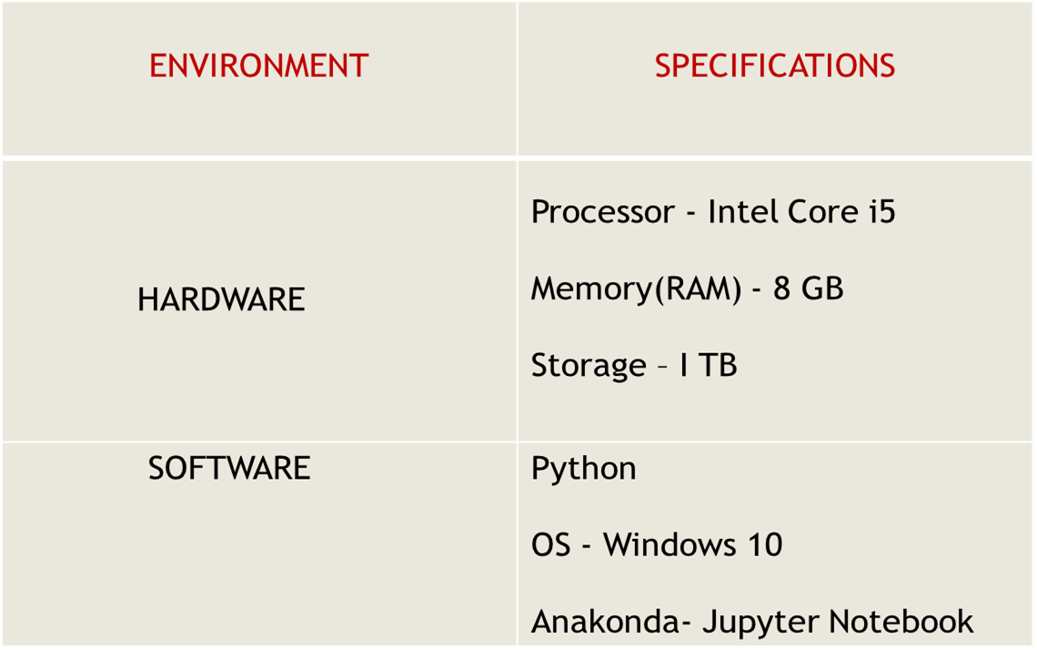
System Requirements
Why Should I Study this course?
Examples
BVRIT HYDERABAD College of Engineering for Women
,PyCharm

Slide 4
References
Why Should I Study this course?
Examples
BVRIT HYDERABAD College of Engineering for Women
Base Paper
https://www.irjet.net/archives/V7/i4/IRJET-V7I4647.pdf
Reference Paper
https://www.researchgate.net/publication/317420253_A_survey_on_extractive_text_summarization

Slide 5
Thank you

